Slide 1

Sigma Smart Strip
Module
Ranajoy Dutta

Slide 2
Contents
Title | Page
1. Sigma Smart Strip | 3
1.1 Hardware | 4
1.2 GUI | 5
2. Django – Challengers Website | 6
2.1 Login | 7
2.2 Signup | 8
3. Database Connectivity with Onion | 9
4. Smart Strip | 10
4.1 Home Page | 11
4.2 Sign Up | 12
4.3 Login | 13
4.4 Dashboard (before product registration) | 14
4.5 Dashboard (after product registration) | 15
5. Stats-App- Charts | 16

Slide 3
Sigma Smart Strip
Sigma Smart Strip is a product of Gosigmaway LLC.
This is a smart extension cord having wifi connectivity and control via Internet.
It can be used offline just like any usual extension cord. And when connected to internet, it can be controlled from anywhere using any web browser.
User can also see the status(on/off) of each socket in the extension cord.

Slide 4
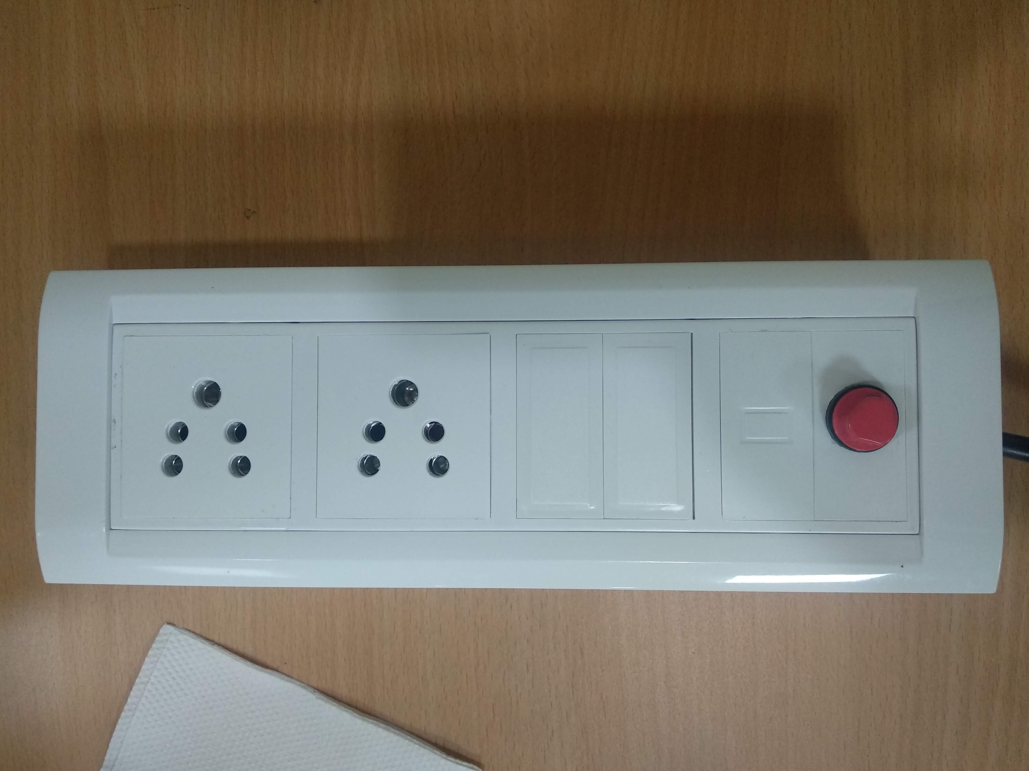
Picture of Sigma Smart Strip
Picture – 2 socket extension cord with Fuse(red)

Slide 5
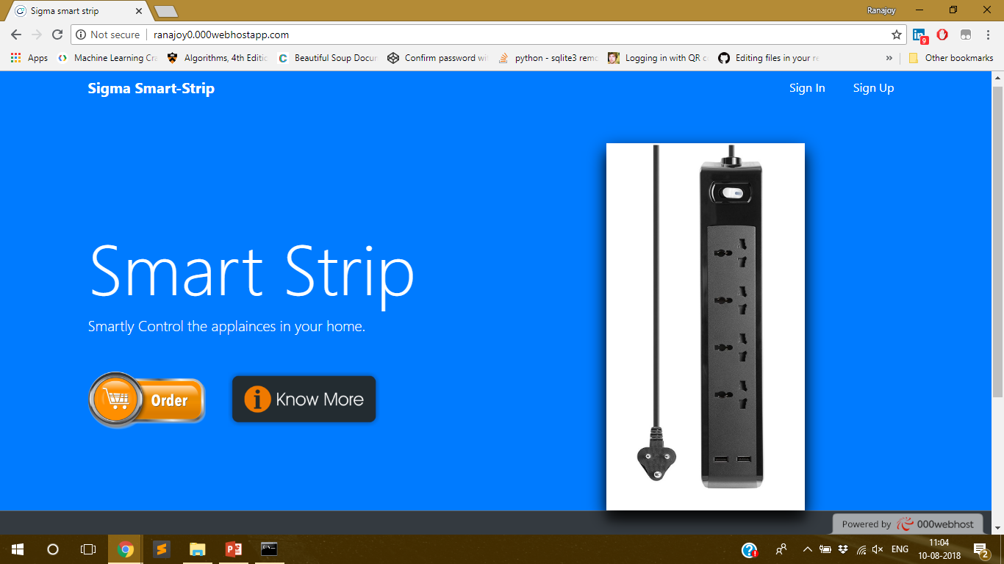
Ranajoy0.000webhostapp.com
Home Page
This is the home page with sign in and sign up option.

Slide 6
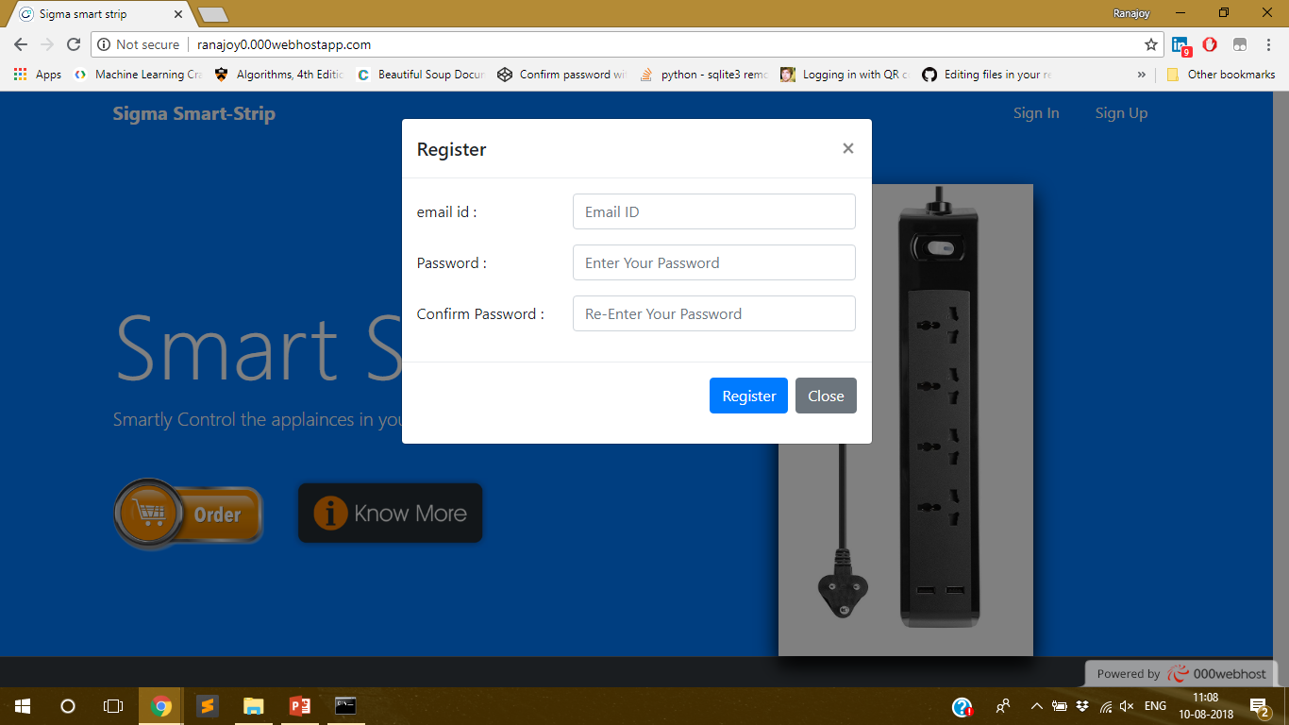
Ranajoy0.000webhostapp.com
Sign Up
User needs to Register their email ID and password.

Slide 7
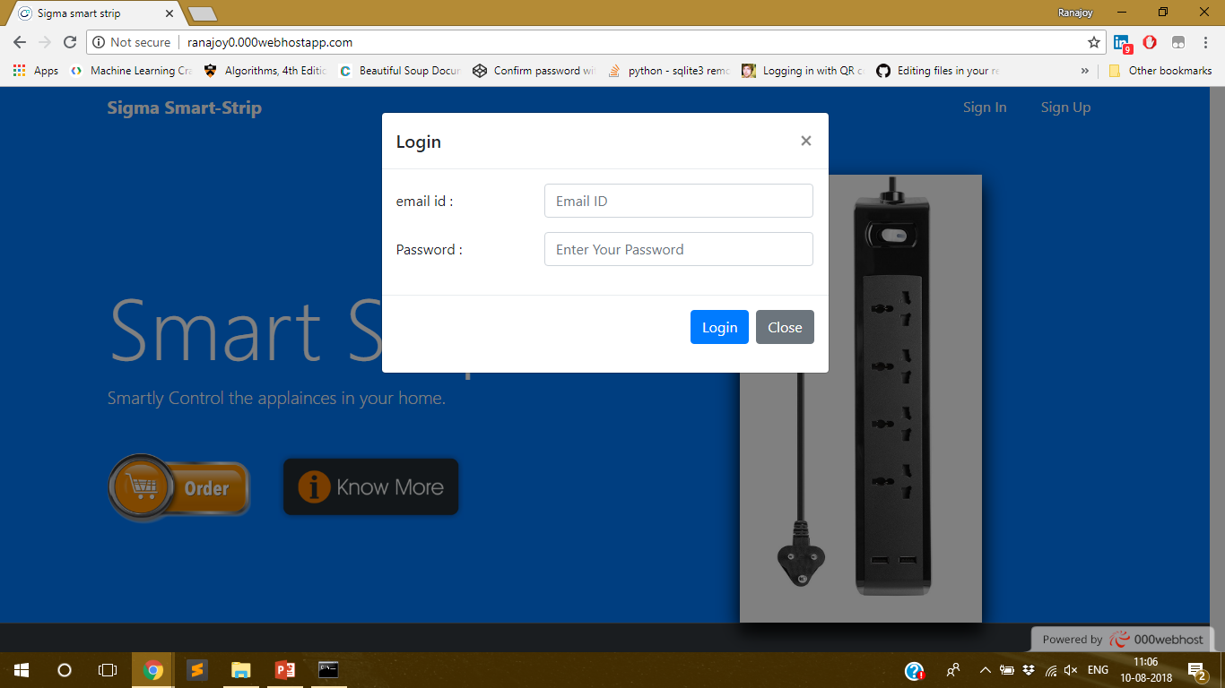
Ranajoy0.000webhostapp.com
Login
User needs to login with registered Email-ID and password.

Slide 8
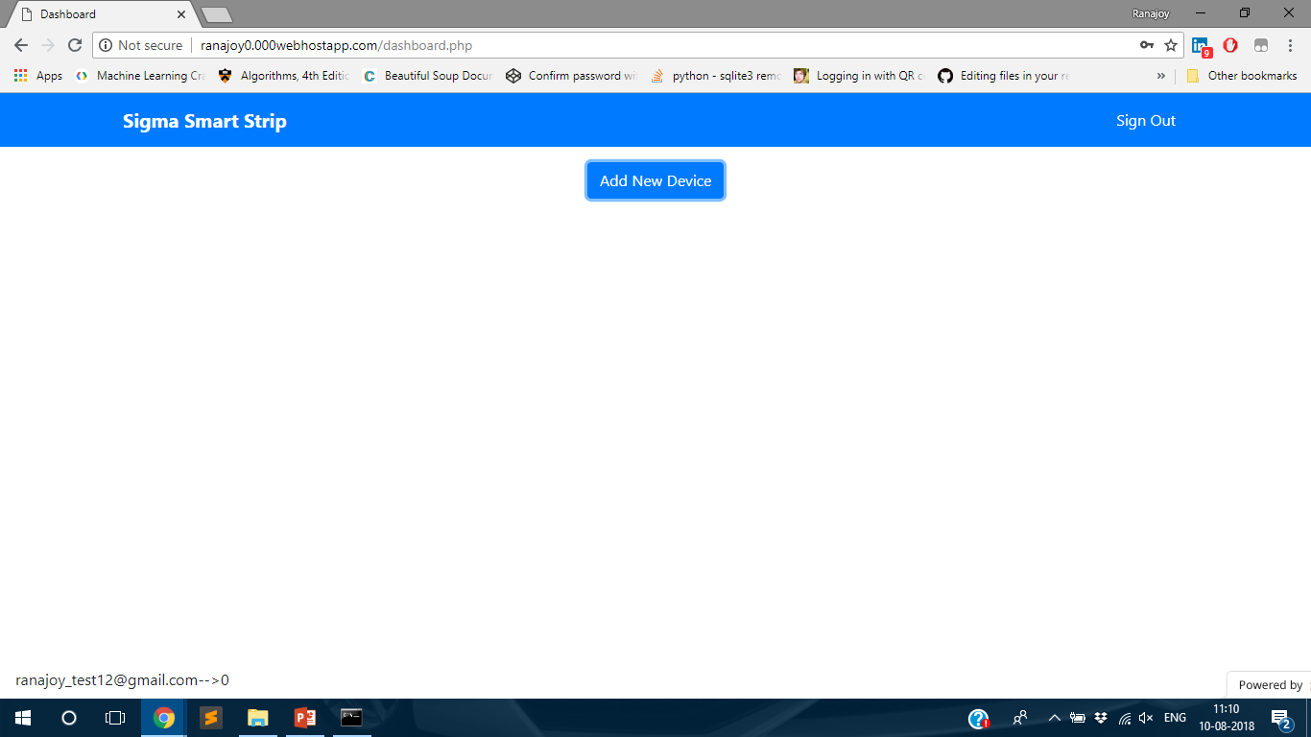
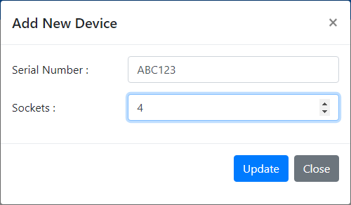
Ranajoy0.000webhostapp.com
Dashboard
(before registering the device)
The user needs to register their device (extension cord) using the serial number provided.

Slide 9
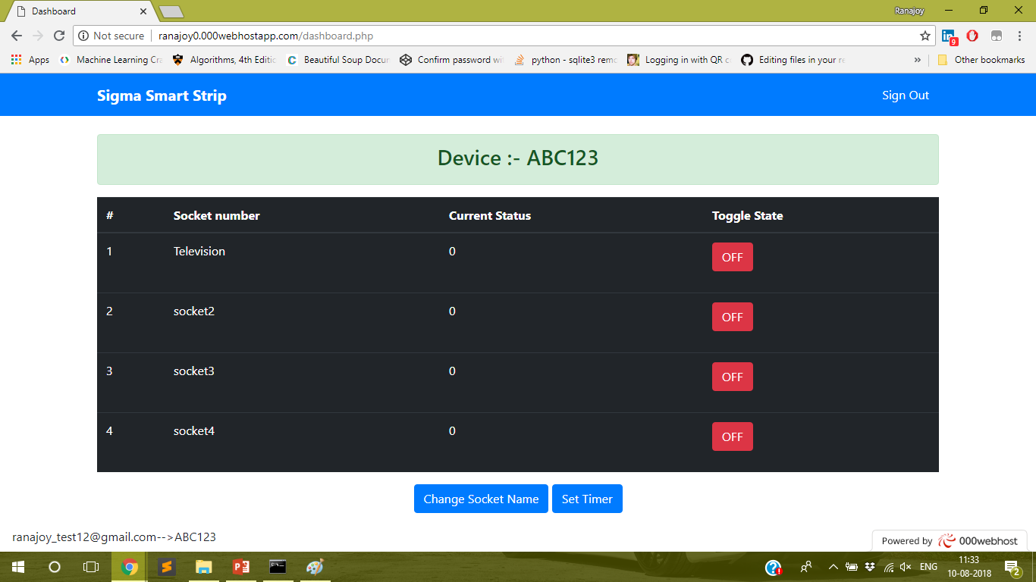
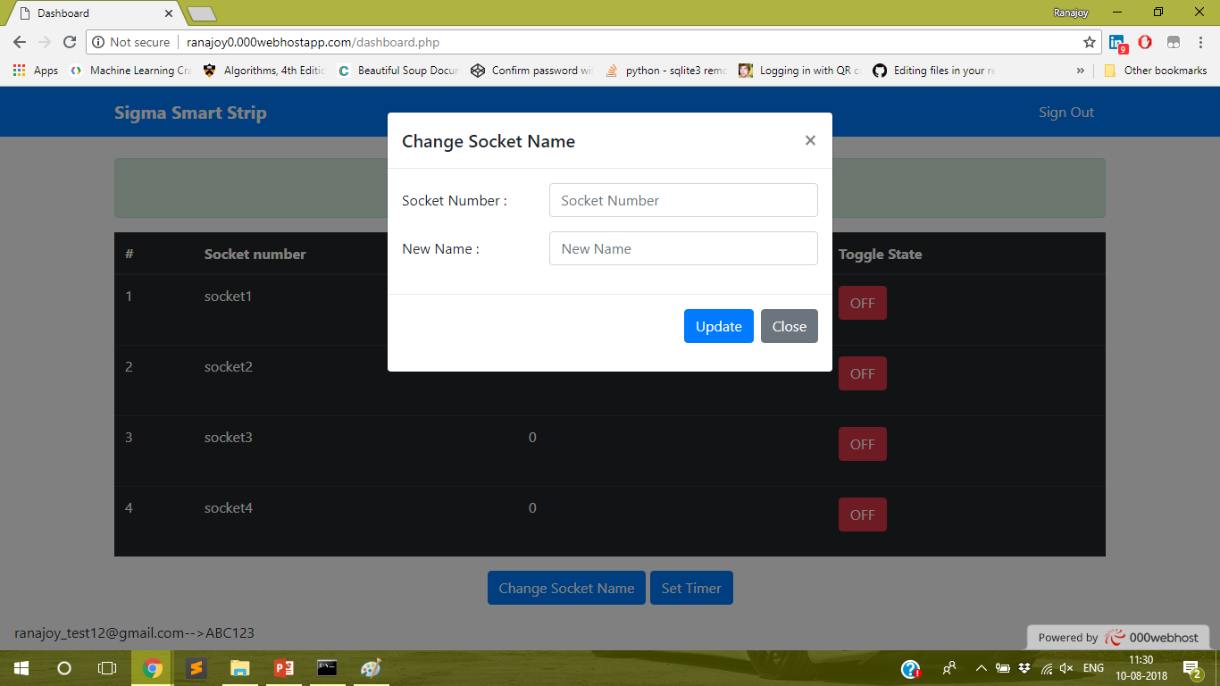

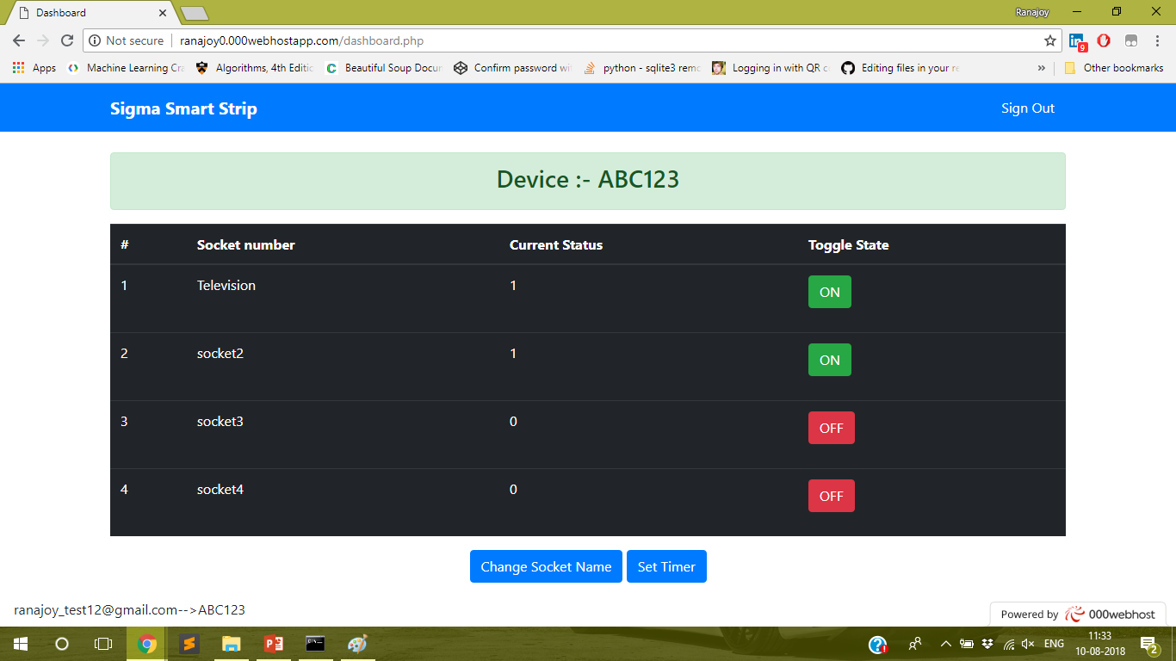
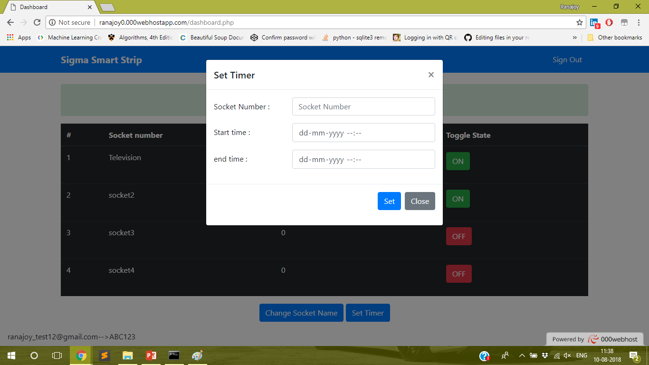
Ranajoy0.000webhostapp.com
Dashboard
(after registering device)

Slide 10
Credentials :-
000webhost credentials :-
Username :- ranajoy.dutta@sigmaway.co
Password :- RanajoyDutta
000webhost DB –
Name :- id6549663_nodemcu
Host :- localhost
User :- id6549663_root
Password :- abc123
Test User Login :-
Email – rohit@gmail.com
Password – 12345
Files.000webhost.com (file manager) :-
User – ranajoy0
Password - RanajoyDutta

Slide 11
Thank You !
Contact US
Nitin Sinha
nitin.sinha@goSigmaWay.com
+1 727-394-4375
+91 7838188809
Debjani Mitra
debjani.mitra@goSigmaWay.com
+1 952-583-3449
+91 9339555636
Ranajoy Dutta
ranajoydutta7@gmail.com
+91 9971807197

